Slide 1
Fochon Pharma
“FOCHON” - Continuing Innovation/Creation
F - Fluorine
O - Oxygen
C - Carbon
H - Hydrogen
O - Oxygen
N - Nitrogen

Slide 2
Fochon’s Mission
“To discover and develop innovative and more effective therapies for diabetes and cancer, and to make a difference in people’s lives”

Slide 3
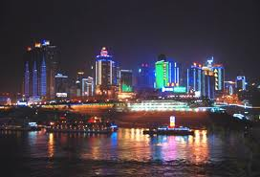
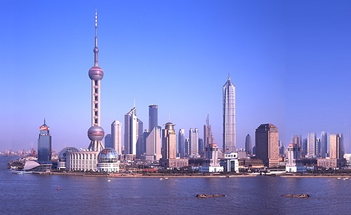
Fochon Utilizes Global Innovation to Maximize Drug Discovery Efficiency
San Francisco Bay Area, US
Experienced scientific team
A network of drug discovery experts
Entrepreneur sprit & Biotech hub
Chongqing & Shanghai, CN
Cost-effective talents and resources
Well established drug discovery &
development infrastructures and
experiences
By fully take the advantage of the time differences between the
two locations, Fochon discovers NMEs around the clock

Slide 4
Creation of Best-In-Class Drugs
Validated Drug Targets
& Druggable Scaffolds
Out-licensing/Partnering
at IND stage
High Risk
High $$$
Fochon Focuses on
Lead Design & Optimization
Discovery
Clinical Development
Lead Discovery
Preclinical
Clinical Trials
Medicinal Chemistry & Structure-Based Drug Design
Metabolism,
Pharmacokinetics, Pharmacology & Toxicology
Target identification
& Validation
Assay Devlop
HTS & Hit-To-Lead
Phase IV
& Post
Marketing Surveillance
Phase
I
Phase
II
Phase
III
Such focus enables Fochon to undertake only projects with a high probability of success in the most capital & time-efficient manner

Slide 5
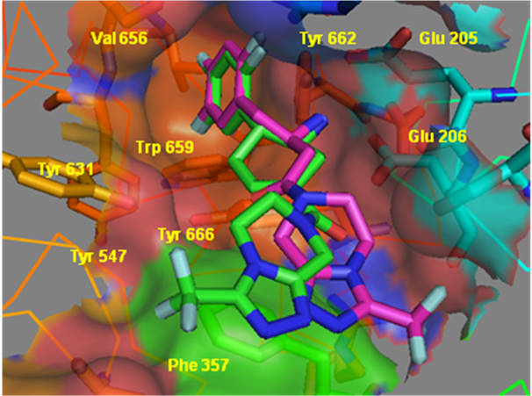
Structure-Based Design of DPP-4 Leads
Superimposing ABT-341 (green) with
MEK-0431(magenta) in DPP-4 binding site
CF₃
CF₃

Slide 6
Fochon's Strong Pipeline Mainly on Cancer and Diabetes
Fotagliptin
(Anti-Diabetes)
Lead Expl.
Lead Optimization
Preclinical Develop.
IND China
Phase I
Pan-Her Kinase
(Anti-Cancer)
Lead Expl.
Lead Optimization
Preclinical Develop.
IND China
Phase I
ALK Kinase
(Anti-Cancer)
Lead Expl.
Lead Optimization
Preclinical Develop.
IND China
Phase I
MEK Kinase
(Anti-Cancer)
Lead Expl.
Lead Optimization
Preclinical Develop.
IND China
Phase I
c-Met
(Anti-Cancer)
Lead Expl.
Lead Optimization
Preclinical Develop.
IND China
Phase I
EGFR/Her2
(Anti-Cancer)
Lead Expl.
Lead Optimization
Preclinical Develop.
IND China
Phase I
PI-3K, BRAF etc.
(Anti-Cancer)
Lead Expl.
Lead Optimization
Preclinical Develop.
IND China
Phase I

Slide 7
Win-Win Collaboration SELLAS
Add drug development capability to Fochon
Make the human talents and excellent research &
development facilities in Greece and Europe
available to Fochon
Similarly, Fochon will open up China & Asia’s
resources to SELLAS
By maximizing the synergy between the two companies, we will build a strong pipeline & a powerhouse that
competes in the global market
Benefit patients all around the world

